Slide 1
Branching Dev-Ops for Watson Assistant Concept: B 10-29-2019 best viewed in presentation mode

Slide 2

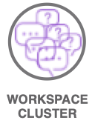
Assistant
workspace
= a single workspace
ASSISTANT
WORKSPACE
Workspace
Cluster
= all workspaces including router workspaces in a single environment a lane holds a single cluster.
WORKSPACE
CLUSTER
Lane
= the promotion path of a cluster.
Dev.
Test
QA

Slide 3
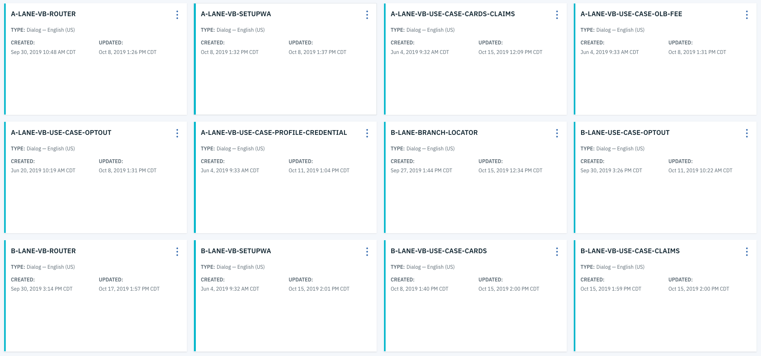
Regions’ Proposed Router Promotion Scheme
Workspace Cluster
Complex WA based solutions may leverage a router workspace that targets supporting workspaces.
Together these comprise a “Workspace Cluster” and include all the workspaces needed for a solution.
To enable multiple developers to work simultaneously complete copies are made of the workspace clusters. Above you can see an “A” Cluster as well as the “B” Cluster.

Slide 4
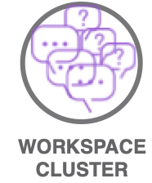
LANE A
LANE B
LANE C
LANE D
LANE E,F,G…
C
DEV
Active Development
Active Development
Merge
TEST
C
Promote
Merge Notification
3 New Entities Found in the C FAQ Workspace 9.15.2019:
1. Credit Card,
2. Savings Account,
3. Location”
1 Entity has been deleted
ATM
Update all? or Walk through each change?
QA
CANARY +-12.5%
Defined in OpenShift Config
PROD
Active Prod
Active Prod
Defined in OpenShift Config
Notes:
Discussion
We believe there is some value in building a merging script that allows the developer to essentially run a diff on the Dev cluster against test and allow for granular approval or rejection of changes.
Rules / Guardrails
What was the plan for lane usage? Define some lane rules. For the greatest simplicity require that each lane represent a separate workspace.
EXAMPLE
The Setup
Production is pointed to Lane A
Lane C and Lane D clusters are created for development. – they can be copied from either the cluster in Test which has the advantage that you capture anything in the pipeline.
As these clusters are created for new development lanes there must be a way to keep the routing pertinent. What is the strategy for this?
We want the Lane C Router workspace to talk to the Lane C workspaces which won’t happen with a simple json copy procedure.
I believe Regions has parameterized the workspace id’s and the orchestration engine routes accordingly but this needs to be confirmed.
Lane C and D are working on the updates in the same workspace: C/D FAQ Workspace
Lane C is making less involved quick changes to a entities and
Lane D is making longer more involved changes to intents
Merging
In this step the dev cluster will get merged with the test cluster baseline. The resulting workspace will stay in the dev environment. The merge happens in-lane, in dev
Merging insures that code changes that get promoted to test have the most recent baseline AND allows developers to workout any bugs in the code before promoting.
Merge script surfaces code changes for approval ie:
“3 New Entities Found in the C FAQ Workspace 9.15.2019: 1. Credit Card, 2. Savings Account, 3. Location”
“1 Entity has been deleted ATM”
Update all? or Walk through each change?
Timestamps and saves the cluster “baseline”
Timestamps and saves the updated components/workspaces.
Once merged the workspace(s) need to be tested
If there are long cycle development efforts they should rebase the cluster frequently to avoid epic rebasing efforts.
Promoting
All lanes promote separately to Test. If multiple lanes are ready to promote, they do so successively.
Promotion script will replicate the Merging step but this time will push changes into the Test environment instead of the Dev environment.
Is there a need for 2 test and QA lanes? We should suggest everything funnel to one test, QA and Canary lane and then promote to the target production environment A or B.
The target production environment continually alternates.
Toolchain
Bamboo
BitBucket
Python Scripts

